Slide 1
ROCK PAPER & SCISSORS

Slide 2
Team #Coding buddies
SHUBHANSHU KAKKAR
ASHUTOSH WAHI
AMITH HARISH
DHRUV SETHI

Slide 3
INTRODUCTION
WE ARE HERE TO PRESENT OUR PROJECT WHICH IS A GAME CALLED “ROCK PAPER AND SCISSORS”

Slide 4



TECH STACK
HTML
CSS
JAVA SCRIPT

Slide 5

ABOUT THE GAME
On the count of three (usually accompanied by a chant of “Rock, Paper, Scissors”), each time raising one hand in a fist and swinging it down on the count, opposing players “throw” their selection into the middle.

Slide 6
GAME RULES
Rock is designated by maintaining the fist, Scissors by extending the middle and index fingers, and Paper by holding the hand out flat.
If players throw out the same gesture, then it’s a tie .
If not, it’s decided by a harmonic and intransitive method — rock crushes scissors, scissors cuts paper, but paper covers rock.

Slide 7
What game is for?
Our project is about game rock paper and scissors feeling tired of online classes or your office work ? You can play it between your boring lectures and meetings or in breaks to relax your mind and to have fun
Who can play this game?
anyone with +3 years of age can easily play this game.

Slide 8
HTML
HTML stands for Hyper Text Markup Language.
It is the standard markup language for creating Web pages.
It describes the structure of a Web page.
It consists of a series of elements.
HTML elements tell the browser how to display the content.

Slide 9
css
CSS stands for Cascading Style Sheets.
It describes how HTML elements are to be displayed on screen, paper, or in other media.
It saves a lot of work. It can control the layout of multiple web pages all at once
External stylesheets are stored in CSS files.

Slide 10
JAVA SCRIPT
JavaScript ("JS" for short) is a full-fledged dynamic programming language that can add interactivity to a website.This happens in games, in the behavior of responses when buttons are pressed or with data entry on forms; with dynamic styling; with animation, etc.

Slide 11
Credits
Special thanks to :
CODECHEF CHAPTER ADGITM
CODECHEF CHAPTER MAIT
CODECHEF CHAPTER IIST

Slide 12
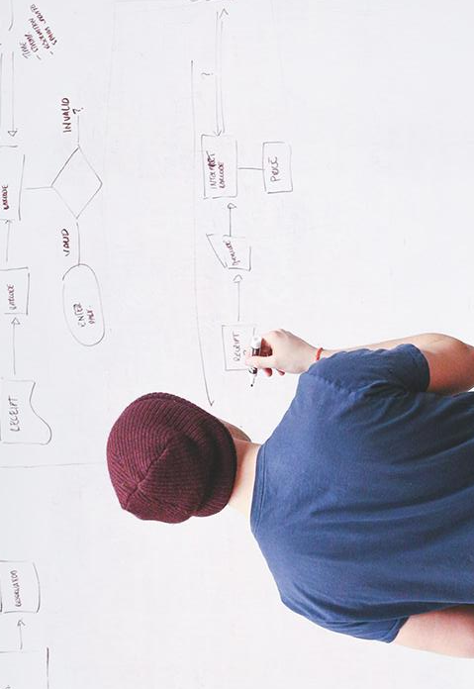
THANK YOU

